Slide 1
Chapter 16
The Consumer Price Index and Government Statistics
Lecture Slides

Slide 2
Case Study: The Consumer Price Index and Government Statistics 1
The three career-home-run leaders are Barry Bonds (762 career home runs at the end of the 2007 season), Hank Aaron (755 career home runs), and Babe Ruth (714 career home runs).
Bonds’s highest salary was $22,000,000 in 2005. Aaron’s highest salary was $250,000 in 1976.
Ruth’s highest salary was $80,000 in 1931.

Slide 3
Case Study: The Consumer Price Index and Government Statistics 2
Bonds’s highest salary is by far the largest. Does this mean he is clearly the best of the three?
A dollar in 1931 bought a lot more than a dollar in 1976, and both bought more than a dollar in 2005. Maybe, in terms of buying power, Aaron’s or Ruth’s salary is highest.
By the end of this chapter, you will be able to determine whether Bonds, Aaron, or Ruth had the highest salary in terms of buying power.

Slide 4
Case Study: The Consumer Price Index and Government Statistics 3
A dollar in 2015 did not buy as much as a dollar in 1984, so 1984 salaries cannot be directly compared with 2015 salaries.
The fact that the dollar has steadily lost buying power over time means that we must make an adjustment whenever we compare dollar values from different years.
The adjustment is easy. What is not easy is measuring the changing buying power of the dollar. The government’s Consumer Price Index (CPI) is the tool we need.

Slide 5
Index Numbers 1
The CPI is a numerical description called an index number.
We can attach an index number to any quantitative variable that we measure repeatedly over time.
The idea of the index number is to give a picture of changes in a variable much like that drawn by saying, “The average cost of a hospital rose 90.2% between 2000 and 2010.”
An index number describes the percent change from a base period.

Slide 6
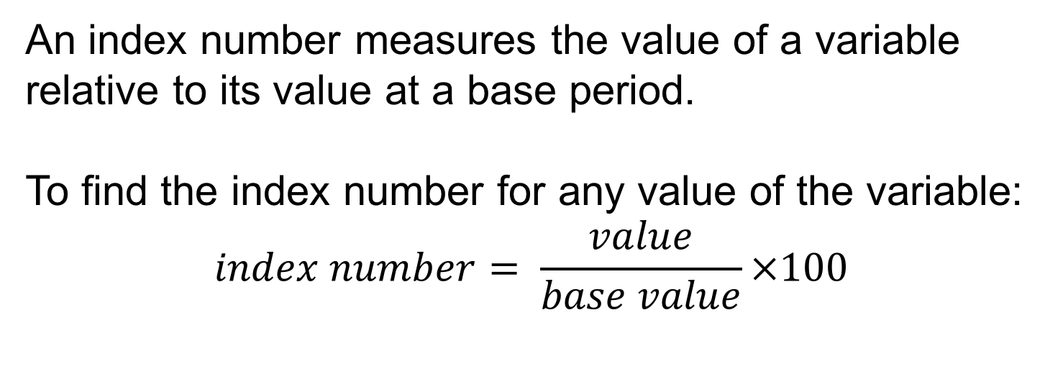
Index Numbers 2
An index number measures the value of a variable relative to its value at a base period.
To find the index number for any value of the variable:
$$index number= \frac{value}{base value}×100$$

Slide 7
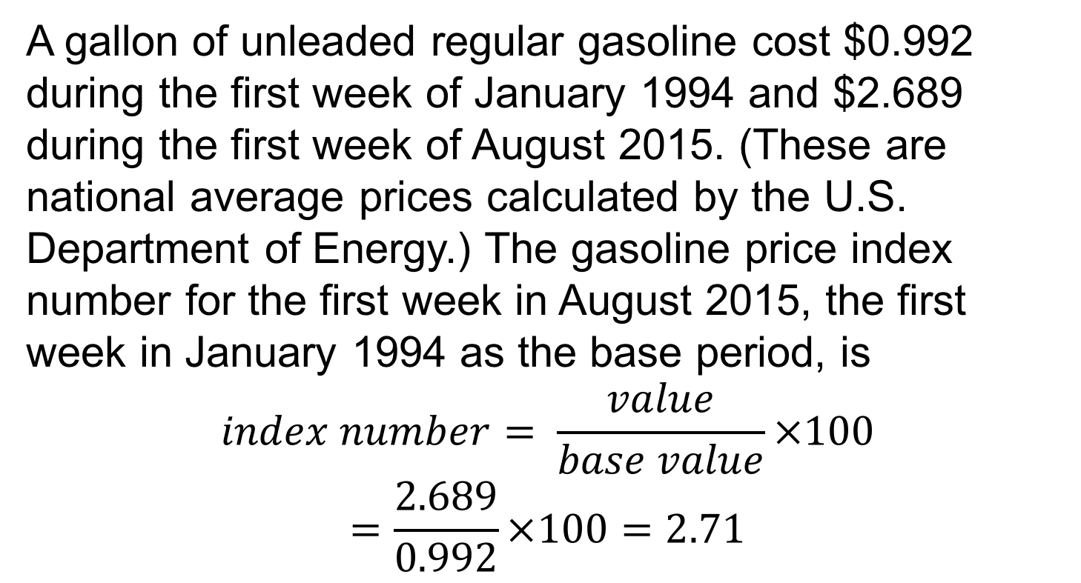
Example: Calculating an index number
A gallon of unleaded regular gasoline cost $0.992 during the first week of January 1994 and $2.689 during the first week of August 2015. (These are national average prices calculated by the U.S. Department of Energy.) The gasoline price index number for the first week in August 2015, the first week in January 1994 as the base period, is
$$index number= \frac{value}{base value}×100$$
$$=\frac{2.689}{0.992}×100=2.71$$

Slide 8
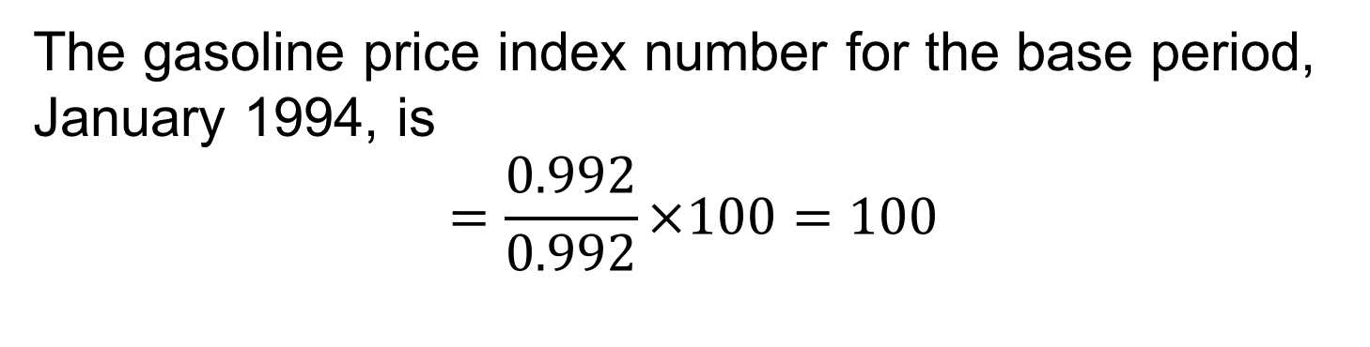
Example: Calculating an index number (continued)
The gasoline price index number for the base period, January 1994, is
$$=\frac{0.992}{0.992}×100=100$$

Slide 9
Index Numbers 3
Because the index number for the base period is always 100, it is usual to identify the base period as 1994 by writing “1994 = 100.”
In news reports concerning the CPI, you will notice the mysterious equation “1982–84 = 100.”
That’s shorthand for the fact that the years 1982 to 1984 are the base period for the CPI.

Slide 10
Index Numbers 4
An index number just gives the current value as a percent of the base value.
Index number 271.1 means 271.1% of the base value, or a 171.1% increase from the base value.
Index number 57 means that the current value is 57% of the base, a 43% decrease.

Slide 11
Fixed Market Basket Price Indexes
Why say, “The Consumer Price Index (1982–84 = 100) stood at 238.7 in July 2015,” instead of “Consumer prices rose 138.7% between the 1982–84 average and July 2015”?
The term index number usually means more than a measure of change relative to a base. It also tells us the kind of variable whose change we measure.
That variable is a weighted average of several quantities, with fixed weights. Let’s illustrate the idea by a simple price index.

Slide 12
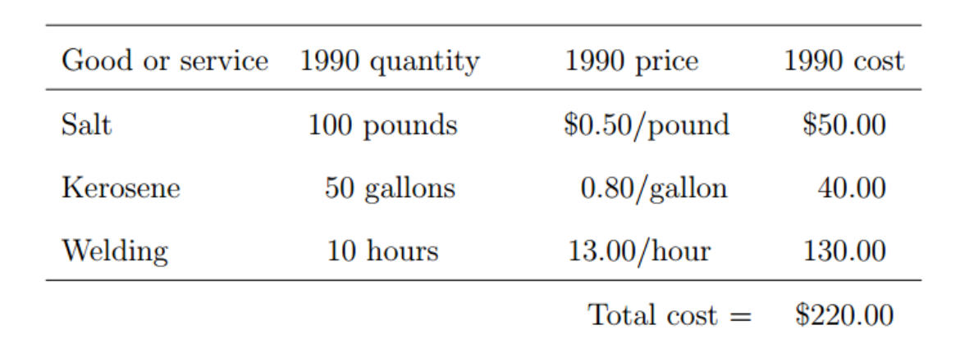
Example: The mountain man price index 1
Bill Smith lives in a cabin and strives for self-sufficiency. He buys only salt, kerosene, and the services of a professional welder. Here are Bill’s purchases in 1990, the base period.

Slide 13
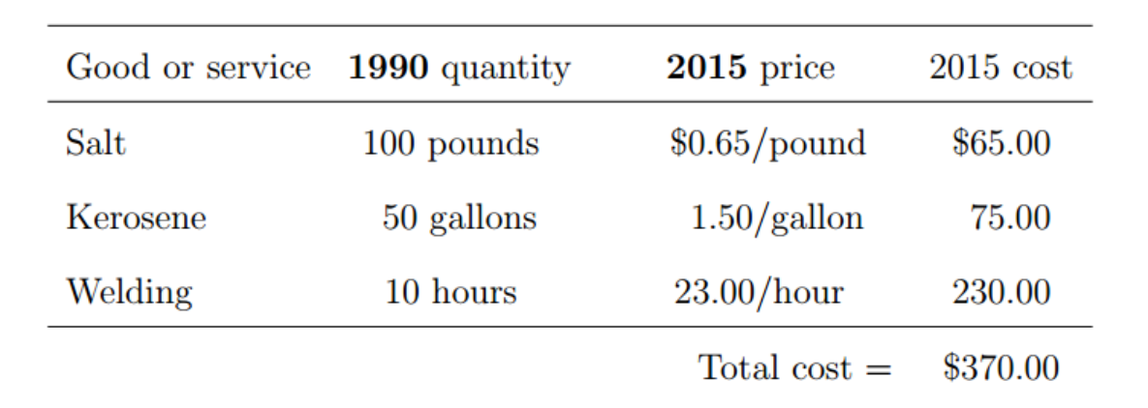
Example: The mountain man price index 2
The total cost of Bill’s collection of goods and services in 1990 was $220. To find the “Mountain Man Price Index” for 2015, we use 2015 prices to calculate the 2015 cost of this same collection of goods and services. Here is the calculation:

Slide 14
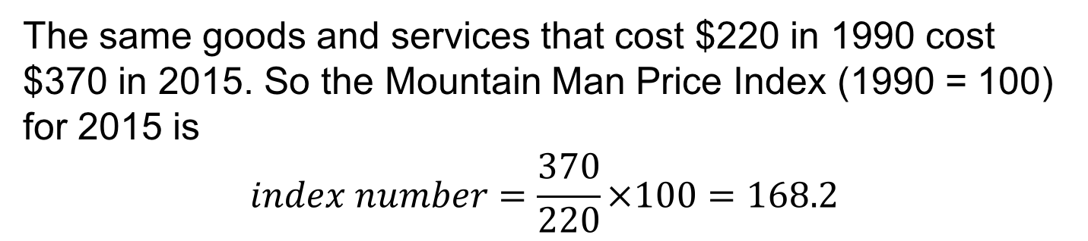
Example: The mountain man price index 3
The same goods and services that cost $220 in 1990 cost $370 in 2015. So the Mountain Man Price Index (1990 = 100) for 2015 is
$$index number=\frac{370}{220}×100=168.2$$

Slide 15
Index Numbers 5
The point of the previous example is that we follow the cost of the same collection of goods and services over time.
It may be that Bill refused to hire the welder in 2015 because he could not afford him. No matter; the index number uses the 1990 quantities, ignoring any changes in Bill’s purchases between 1990 and 2015.
We call the collection of goods and services whose total cost we follow a market basket. The index number is then a fixed market basket price index.

Slide 16
Index Numbers 6
A fixed market basket price index is an index number for the total cost of a fixed collection of goods and services.
The basic idea of a fixed market basket price index is that the weight given to each component (salt, kerosene, welding) remains fixed over time.

Slide 17
Index Numbers 7
The CPI is, in essence, a fixed market basket price index, with several hundred items that represent all consumer purchases.
Holding the market basket fixed allows a legitimate comparison of prices because we compare the prices of exactly the same items at each time.
As we will see, it also poses severe problems for the CPI.

Slide 18
Use the CPI 1
For now, think of the CPI as an index number for the cost of everything that American consumers buy.
That the CPI for July 2015 was 238.7 means that we must spend $238.7 in July 2015 to buy goods and services that cost $100 in the 1982 to 1984 base period.
An index number for “the cost of everything” lets us compare dollar amounts from different years by converting all the amounts into dollars of the same year.

Slide 19
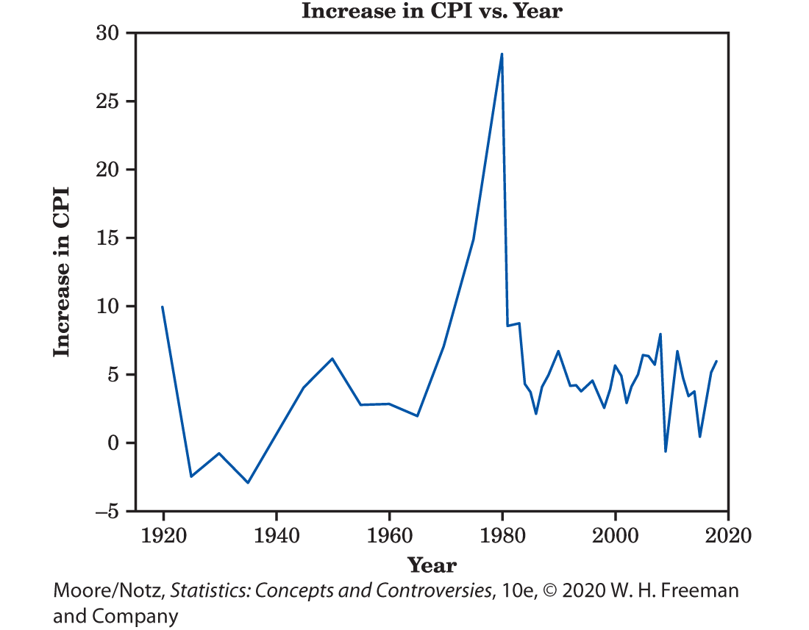
Use the CPI 2
Figure 16.1 is a line graph of the annual percent increase in CPI values. It shows that the periods from 1915 to 1920, the 1940s, and from 1975 to 1985 experienced high inflation. Although there is considerable variation, the annual percent increase is positive in most years.

Slide 20
Example: Salaries of Professional Athletes
The mean salary of Major League Baseball players rose from $329,408 in 1984 to $3,386,212 in 2015.
How big was the increase in real terms? Let’s convert the 1984 average into July 2015 dollars.
The annual average CPI for 1984 was 103.9, and, previously, we mentioned that the CPI was $238.7 in July 2015.

Slide 21
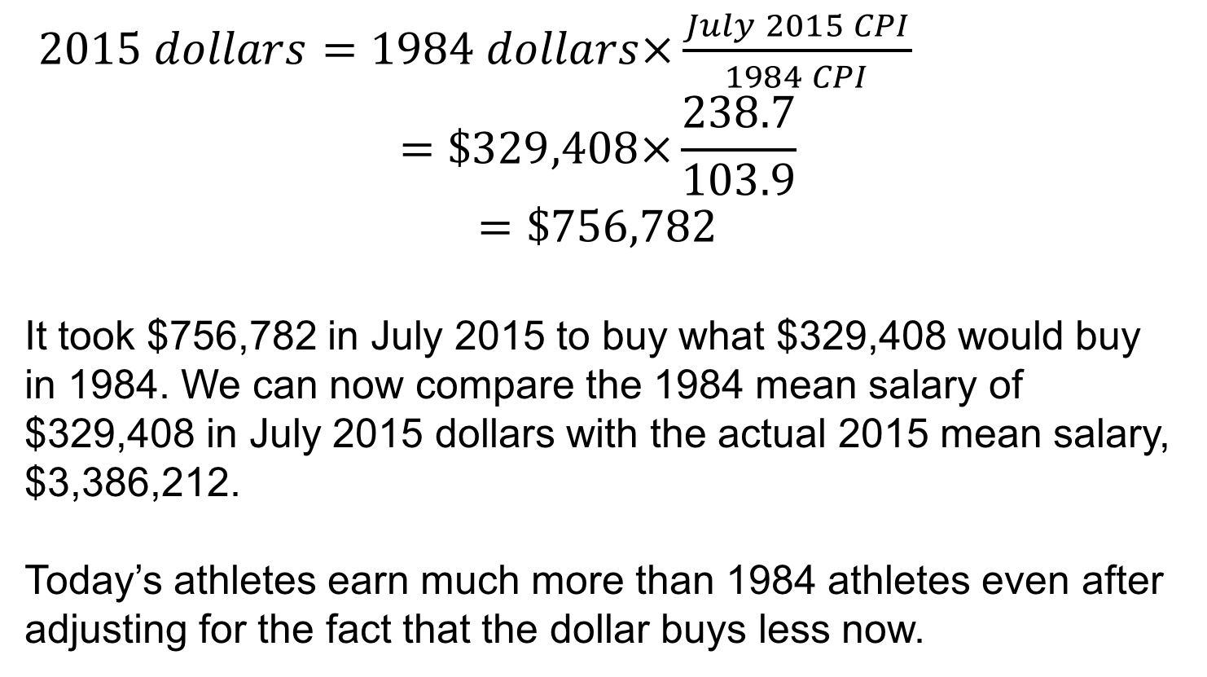
Example: Salaries of Professional Athletes (continued)
$2015 dollars=1984 dollars×\frac{July 2015 CPI}{1984 CPI}$
$$=\$329,408×\frac{238.7}{103.9}$$
$$=\$756,782$$
It took $756,782 in July 2015 to buy what $329,408 would buy in 1984. We can now compare the 1984 mean salary of $329,408 in July 2015 dollars with the actual 2015 mean salary, $3,386,212.
Today’s athletes earn much more than 1984 athletes even after adjusting for the fact that the dollar buys less now.

Slide 22
Understanding the CPI 1
The idea of the CPI is that it is an index number for the cost of everything American consumers buy.
That idea needs lots of adjusting to be practical. Much of the fiddling uses the results of large sample surveys.
Who is covered? The official name for the common version of the CPI is the Consumer Price Index for All Urban Consumers. The CPI market basket represents the purchases of people living in urban areas. If you live on a farm, the CPI doesn’t apply to you.

Slide 23
Understanding the CPI 2
How is the market basket chosen?
Different households buy different things. The Consumer Expenditure Survey gathers detailed data on the spending of more than 30,000 households. The Bureau of Labor Statistics (BLS) breaks spending into categories such as “fresh fruits and vegetables” and “new and used motor vehicles.” Then it chooses specific items, such as “fresh oranges,” and gives weights proportional to that category’s spending. The weights and the specific market basket items are updated regularly to keep up with changing buying habits. So the market basket isn’t actually fixed.

Slide 24
Understanding the CPI 3
How are the prices determined?
From more sample surveys. The BLS must discover the price of “fresh oranges” every month. That price differs from city to city and from store to store in the same city. Each month, the BLS records 80,000 prices in 87 cities at a sample of stores. The Point of Purchase Survey of 16,800 households keeps the BLS up-to-date on where consumers shop for each category of goods and services (supermarkets, convenience stores, discount stores, and so on).

Slide 25
Understanding the CPI 4
Does the CPI measure changes in the cost of living? A fixed market basket price index measures the cost of living the same over time.
We don’t keep buying the same market basket of goods and services over time.
We switch from LP records to tapes and CDs and then to music downloads. We don’t buy new 1995 cars in 2005 or 2015.
As prices change, we change what we buy.

Slide 26
Understanding the CPI 5
The BLS tries hard to keep its market basket up-to-date and to compensate for changes in quality.
Every year, for example, the BLS must decide how much of the increase in new-car prices is paying for better quality.
House prices are another problem for the BLS. People buy houses partly to live in and partly because they think owning a house is a good investment. If we pay more for a house because we think it’s a good investment, the full price should not go into the CPI.

Slide 27
Understanding the CPI 6
It is clear the CPI is not a fixed market basket price index, though that is the best way to start thinking about it.
The BLS must constantly change the market basket as new products appear and our buying habits change. It must adjust the prices its sample surveys record to take account of better quality and the investment component of house prices.
The CPI still does not measure all changes in our cost of living. It leaves out taxes, for example, which are certainly part of our cost of living.

Slide 28
Understanding the CPI 7
In principle, a true cost-of living index would measure the cost of the same standard of living over time.
We start with a fixed market basket price index, which also measures the cost of living the same over time but takes the simple view that “the same” means buying exactly the same things.
If we switch from beef to tofu to avoid paying more for beef and are just as satisfied, our standard of living hasn’t changed and a cost-of-living index should ignore the higher price of beef.

Slide 29
Understanding the CPI 8
If we are willing to pay more for products that keep our environment clean, we are paying for a higher standard of living, and the index should treat this just like an improvement in the quality of a new car.
The BLS says that it would like the CPI to track changes in the cost of living, but that a true cost-of-living index isn’t possible in the real world.

Slide 30
The Place of Government Statistics 1
Modern nations run on statistics.
Economic data guide government policy and inform the decisions of private business and individuals.
Price indexes and unemployment rates, along with many other, less publicized series of data, are produced by government statistical offices.
The United States has 72 federal statistical offices, with relatively weak coordination among them.

Slide 31
The Place of Government Statistics 2
The Census Bureau and the Bureau of Labor Statistics are the largest, but you may, at times, use the products of the Bureau of Economic Analysis, the National Center for Health Statistics, the Bureau of Justice Statistics, or others in the federal government’s collection of statistical agencies.
Citizens need data that are accurate and timely and that keep up with changes in society and the economy.
Producing accurate data quickly demands considerable resources.

Slide 32
The Place of Government Statistics 3
Freedom from political influence is as important to government statistics as accuracy and timeliness.
When a statistical office is part of a government ministry, it can be influenced by the needs and desires of that ministry.
The Census Bureau is in the Department of Commerce, which serves business interests. The BLS is in the Department of Labor.
Business and labor each have their own statistical office.

Slide 33
The Question of Social Statistics 1
The government produces many data on social issues such as education, health, housing, and crime.
Social statistics are less complete than economic statistics.
We have good data about how much money is spent on food but less information about how many people are poorly nourished. Social data are also less carefully produced than economic data.

Slide 34
The Question of Social Statistics 2
Economic statistics are generally based on larger samples, are compiled more often, and are published with a shorter time lag.
Economic data are used by the government to guide economic policy month by month. Social data help us understand our society and address its problems but are not needed for short-term management.

Slide 35
The Question of Social Statistics 3
How can we get accurate information about social issues, collected consistently over time, and yet not entangle the government with sex, religion, and other touchy subjects?
The solution in the United States has been government funding of university sample surveys.
After first deciding to undertake a sample survey asking people about their sexual behavior, in part to guide AIDS policy, the government backed away.

Slide 36
The Question of Social Statistics 4
The U.S. government, instead, funded a much smaller survey of 3452 adults by the University of Chicago’s National Opinion Research Center (NORC).
NORC’s General Social Survey (GSS), funded by the government’s National Science Foundation, belongs with the Current Population Survey and the samples that undergird the CPI on any list of the most important sample surveys in the United States.

Slide 37
The Question of Social Statistics 5
The GSS includes both “fact” and “opinion” items.
Respondents answer questions about their job security, their job satisfaction, and their satisfaction with their city, their friends, and their families. They talk about race, religion, and sex.
Many Americans would object if the government were to ask if they had seen an X-rated movie in the past year, but they reply when the GSS asks this question.

Slide 38
Statistics in Summary 1
An index number describes the value of a variable relative to its value at some base period.
A fixed market basket price index is an index number that describes the total cost of a collection of goods and services.
Think of the government’s Consumer Price Index (CPI) as a fixed market basket price index for the collection of all the goods and services that consumers buy.

Slide 39
Statistics in Summary 2
Because the CPI shows how consumer prices change over time, we can use it to change a dollar amount at one time into the amount, at another time, that has the same buying power. This is needed to compare dollar values from different times in real terms.
The details of the CPI are complex. It uses data from several large sample surveys. It is not a true fixed market basket price index because of adjustments for changing buying habits, new products, and improved quality.

Slide 40
Statistics in Summary 3
Government statistical offices produce data needed for government policy and decisions by businesses and individuals. The data should be accurate, timely, and free from political interference. Therefore, citizens have a stake in the competence and independence of government statistical offices.

